Slide 1
1. Set up calculations of iron speciation and solubility via the code ORCHESTRA
objects.txt
minteqv4.txt
adsmodels.txt
Input.dat
Output.dat
Chemistry.inp
Composer.inp
Documentation.inp
Concert.xml
orchestra.jar

Slide 2
Set up files in ORCHESTRA
Run the code ORCHESTRA by the Java executive program orchestra.jar

Slide 3
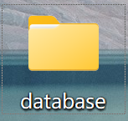
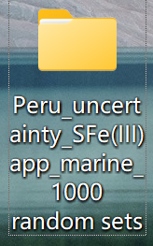
2. Set up uncertainty analysis via ORCHESTRA-PEST++
2.1 Generate post-calibrated random sets via PESTPP-IES
objects.txt
minteqv4.txt
Code in Fe.pst changed from PESTPP-IES to PESTPP-SWP
adsmodels.txt
If it incoporates with PESTPP-IES to generate post-calibrated random parameters, then it needs to add these files in this subfolder.
Input.dat
Output.dat
Output_pest.dat
Chemistry.inp
Output.ins
Composer.inp
Fe.pst
Documentation.inp
Chemistryl.tpl
Concert.xml
Orchestra_pest.bat
orchestra.jar

Slide 4
2. Set up uncertainty analysis via ORCHESTRA-PEST++
2.2 incorporate generated random sets via PESTPP-SWP
objects.txt
minteqv4.txt
adsmodels.txt
If it incoporates with PESTPP-SWP to using generated parameters to calculate apparent iron solubility , then it needs to add these files in this subfolder.
Input.dat
Output.dat
Output_pest.dat
Chemistry.inp
Output.ins
Composer.inp
Fe.pst
Documentation.inp
Chemistryl.tpl
Concert.xml
Orchestra_pest.bat
orchestra.jar

Slide 5
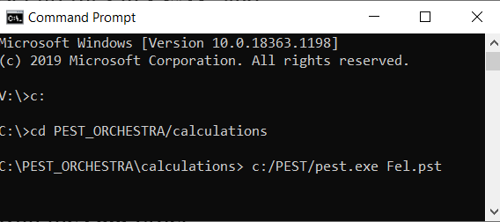
Set up files in ORCHESTRA-PEST++
Run the cmd order using Command Prompt in windows. Firstly, using cd order to find the folder within ORCHESTRA-PEST++. Then, start the PEST++ by running pestpp-ies.exe or pestpp-swp.exe under this folder.

Slide 6
3. Set up sensitivity analysis via ORCHESTRA-PEST++
objects.txt
Code in Fe.pst changed among PESTPP-IES, PESTPP-SWP and PESTPP-SEN.
minteqv4.txt
adsmodels.txt
If it incoporates with PESTPP-SEN to generate post-calibrated random parameters, then it needs to add these files in this subfolder.
Input.dat
Output.dat
Output_pest.dat
Chemistry.inp
Output.ins
Composer.inp
Fe.pst
Documentation.inp
Chemistryl.tpl
Concert.xml
Orchestra_pest.bat
orchestra.jar

Slide 7
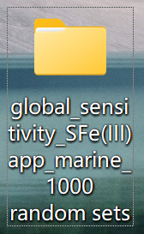
Set up files in ORCHESTRA-PEST++
Run the cmd order using Command Prompt in windows. Firstly, using cd order to find the folder within ORCHESTRA-PEST++. Then, start the PEST++ by running pestpp-sen.exe under this folder.

