Slide 1
Making Data Publicly Available
SOP Training
04/27/2022
Coastal Plains Soil, Water, and Plant Research Center
Florence, SC
U.S. Vegetable Laboratory
Charleston, SC

Slide 2
Ad hoc Data Committee
Vanotti, Billman, Sohoulande
Goals:
Committee was charged to develop an SOP, that coworkers can use to comply with new P&P 630.0 Data Management & Public Access Requirements for ARS, on how to get a digital scientific research data (DSRD):
1) published in a data repository, and
2) catalogued in NAL Ag Data Common,
Process:
We met weekly October 2020-January 2021 to provide a solution. Further editing & piloting of the SOP throughout 2021.
We provided initial training for the Florence location in 2021.
Products:
We have organized a joint training session between Florence & Charleston ARS units to share this process with location research and support staff

Slide 3
Reference and Policy
The policy in this P&P 630.0 lists the following requirements concerning public access for USDA-funded Research Data (for detail see section 4.2 of P&P):
  Digital Scientific Research Data must be “published” in a data repository that can be searchable and usable for analysis by public (i.e re3data.org)
  Digital Scientific Research Data with a digital object identifier (DOI), preserved long-term, machine-readable format
  Timing: Digital Scientific Research Data in the data repository within 12 months after completion of data collection
    “completion of data collection” is defined in the approved DMP of the ARS project plan. Example: 12 months after date of publication of the peer-review article, or 12 months after a decision not to publish a peer-reviewed article based on the data.
d) Digital Scientific Research Data must also be catalogued in NAL (Ag Data Common) with 3 additional pieces of information:
1. USDA funding source
2. Dataset description
3. Associated published research documents
If there is an exception to making data publicly available: Must obtain an extension or waiver from USDA Chief Scientist

Slide 4
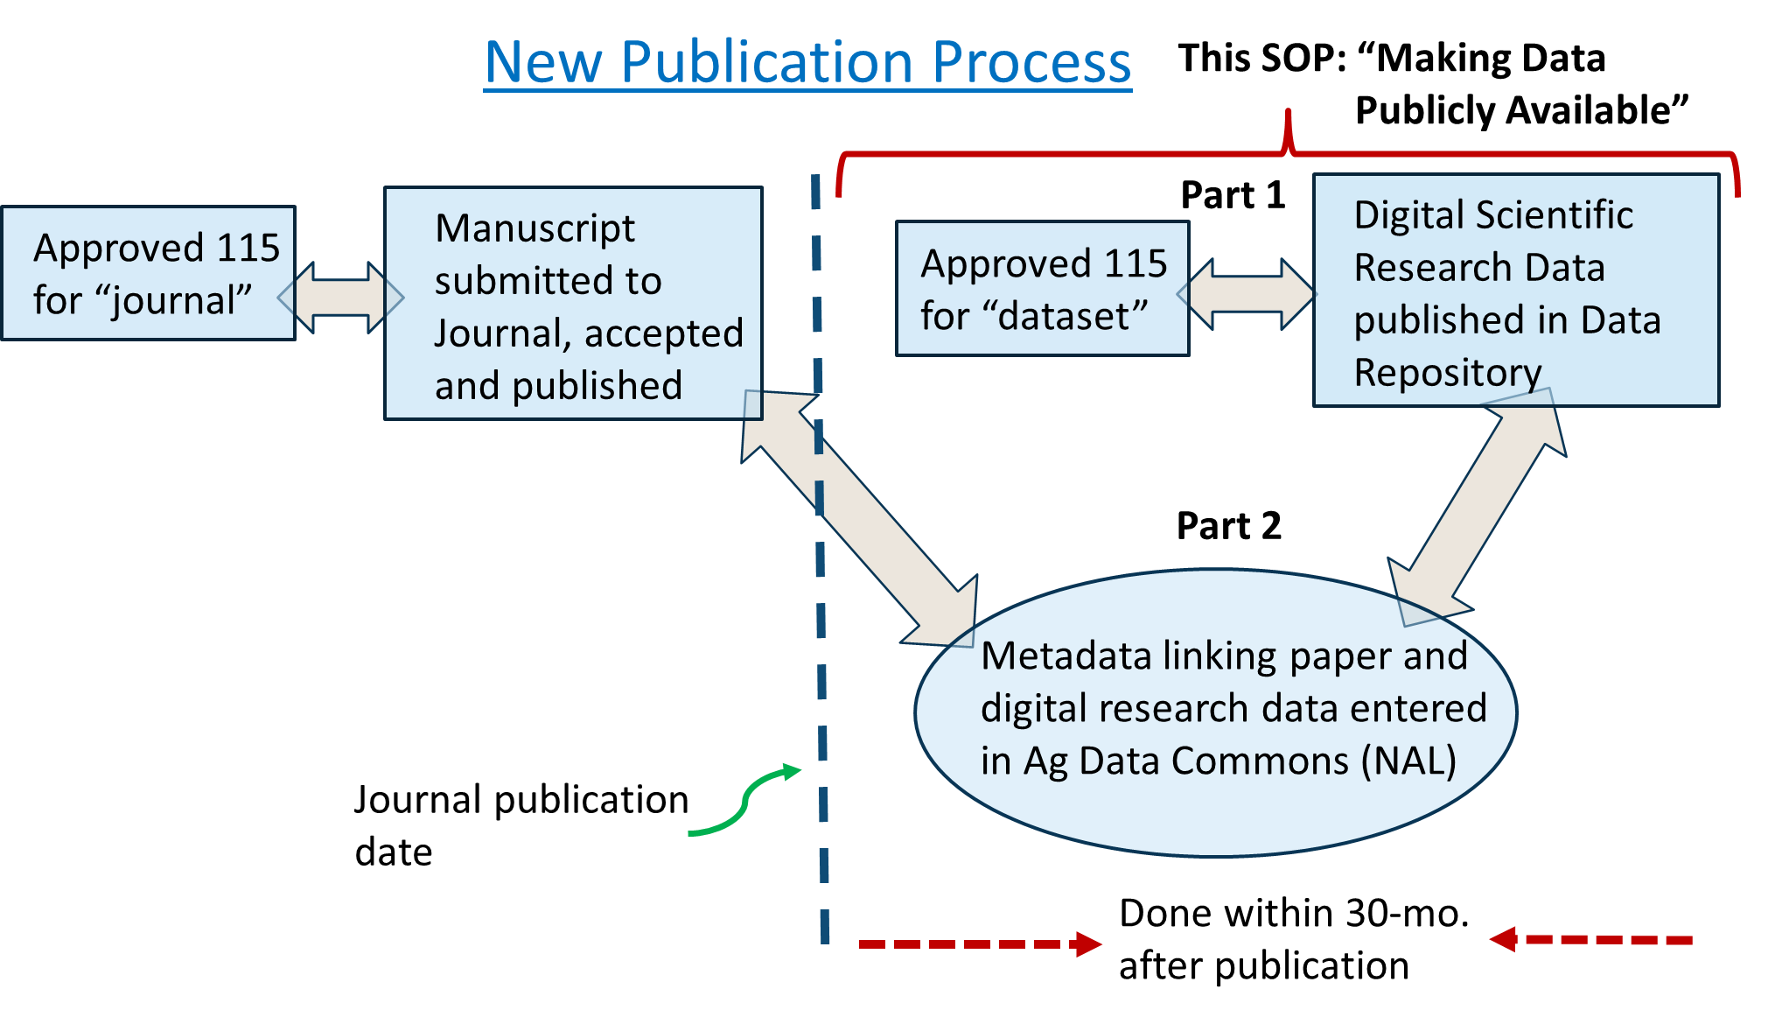

Slide 5
Primary Roles & Responsibilities from P&P 630.0
ARS Scientists:
  Ensure that all ARS research data exists in a machine-readable format in a data repository
  Ensure that a record for each research dataset exists in the Ag Data Commons (metadata)
Lead Scientists:
  Prepare a data management plan (DMP) for CRIS projects that meet the requirements for use of reliable repositories for public access and preservation of data
Research Leaders:
  Ensure that researchers prepare project plans, including a DMP that considers; and considers the long-term storage, public access, and preservation needs for scientific research data, and that the metadata include sufficient detail so the public can effectively reuse the data
  Ensure implementation of a DMP by unit researchers and that the public has access to research data covered by this policy within 12 months of completion of data collection

Slide 6
Users of this SOP
The SOP was developed so that Cat 3 and Technicians involved in data collection and summarization can assist the SY in the additional work required to make the research data publicly available.
However, the SY is fully responsible for:
  1.) Content of the research data made publicly available
  2.) Content and submission of the ARS 115 form for Digital Data
  3.) Content and final submission of digital data to the chosen data repository
  3.) Content and submission of the metadata to the NAL Ag Data Commons

Slide 7
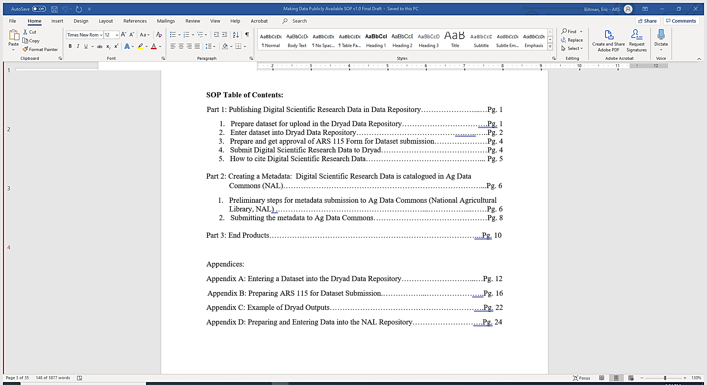

Slide 9
Part 1 Publishing Scientific Data in a Data Repository: TOUR OF DRYAD
We use the Dryad Data Repository as a functional example that will work for any journal publication.
The SY should decide which data repository to use based on convenience, if the journal has its own public repository (e.g., Figshare, part of ASABE), and the cost of publishing in that repository.
The requirements for acceptable data repositories is that they,
must be “published” in a data repository that can be searchable and usable for analysis by public (a list of acceptable repositories can be found at re3data.org)
be given a digital object identifier (DOI), preserved long-term, and machine-readable

Slide 10
Part 1 Publishing Scientific Data in a Data Repository: TOUR OF DRYAD
Logging into Dryad Data Repository
Guided tour through the portal
Final Submission of the digital research data
Viewing the final product in the data repository

Slide 12
Part 2 Adding Metadata in the NAL Ag Data Commons: TOUR OF AG DATA COMMONS
Viewing and filling out the Metadata Template in MS Word
Logging in to Ag Data Commons
Guided tour through the portal
Final Submission of the metadata
Viewing the final product in the Ag Data Commons

Slide 13
Part 3: Final Products

Slide 14
Part 3: Final Products
Example for DATASET A:
Published journal paper: Billman, E. D., Williamson, J. A., Soder, K. J., Andreen, D. M., & Skinner, R. H. (2020). Mob and rotational grazing influence pasture biomass, nutritive value, and species composition. Agronomy Journal, 112(4), 2866-2878. https://doi.org/10.1002/agj2.20215
Published Dataset: Billman, Eric D.; Williamson, Jessica, A.; Soder, Kathy J.; Andreen, Danielle M.; Skinner, R. Howard. (2020). Data from: Mob and rotational grazing influence pasture biomass, nutritive value, and species composition, Dryad, Dataset, https://doi.org/10.5061/dryad.79cnp5ht4 .
Metadata: Billman, Eric D.; Williamson, Jessica, A.; Soder, Kathy J.; Andreen, Danielle M.; Skinner, R. Howard. (2020). Metadata from: Mob and rotational grazing influence pasture biomass, nutritive value, and species composition. Accessed 2021-01-11.Link to Ag Data Commons: https://data.nal.usda.gov/dataset/metadata-mob-and-rotational-grazing-influence-pasture-biomass-nutritive-value-and-species-composition

Slide 15
Part 3: Final Products
Example for DATASET B:
Published journal paper: Sohoulande, C. D., Martin, J., Szogi, A., & Stone, K. (2020). Climate-driven prediction of land water storage anomalies: An outlook for water resources monitoring across the conterminous United States. Journal of Hydrology, 588, 125053. https://doi.org/10.1016/j.jhydrol.2020.125053
Published Dataset: Sohoulande, Clement D.D.; Martin, Jerry; Szogi, Ariel; Stone, Kenneth (2020). Data from: Climate-driven prediction of land water storage anomalies: An outlook for water resources monitoring across the conterminous United States, Dryad, Dataset, https://doi.org/10.5061/dryad.qnk98sfdz
Metadata: Sohoulande, Clement. (2020). Metadata for: Climate-driven prediction of land water storage anomalies: An outlook for water resources monitoring across the conterminous United States. Link to Ag Data Commons: https://data.nal.usda.gov/dataset/metadata-climate-driven-prediction-land-water-storage-anomalies-outlook-water-resources-monitoring-across-conterminous-united-states

Slide 16
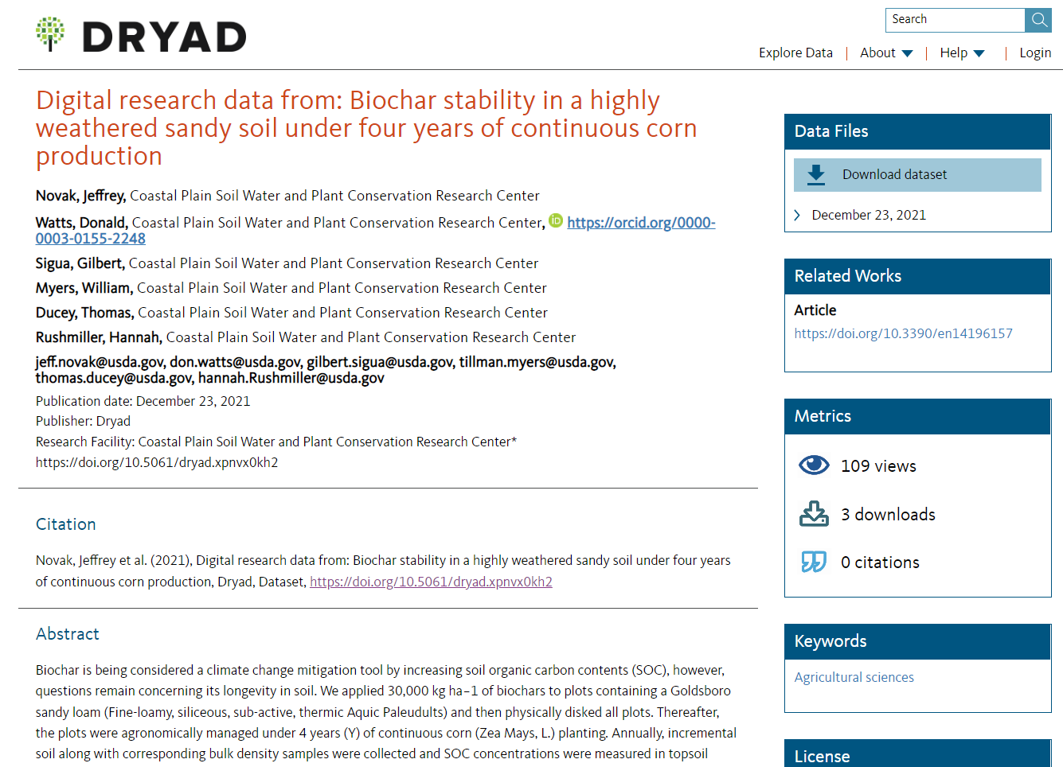
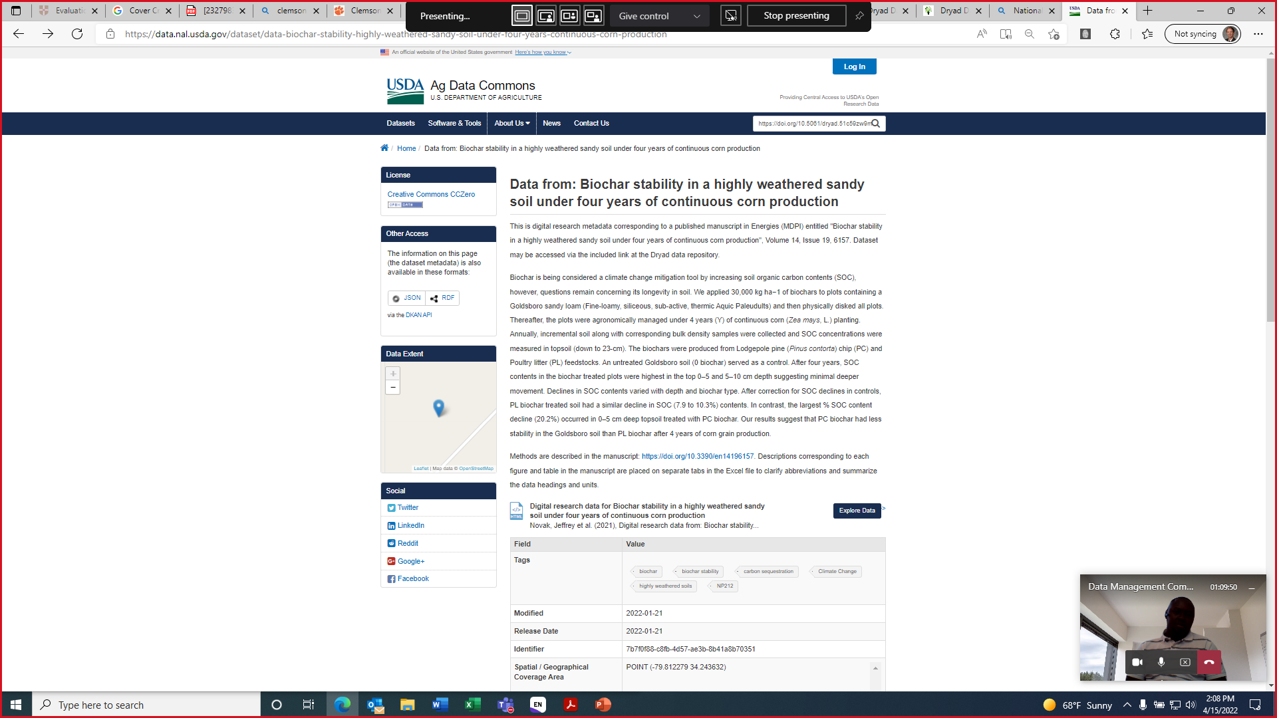
Examples of SOP Implementation:
Data from: Biochar stability in a highly weathered sandy soil under four years of continuous corn production
Published dataset: https://doi.org/10.5061/dryad.xpnvx0kh2
Metadata: https://data.nal.usda.gov/dataset/data-biochar-stability-highly-weathered-sandy-soil-under-four-years-continuous-corn-production

Slide 17
Ad hoc Data Management Committee
Thank you for your time.
QUESTIONS?
Dr. Matias Vanotti
Dr. Eric Billman
Dr. Clement Sohoulande

