Slide 1
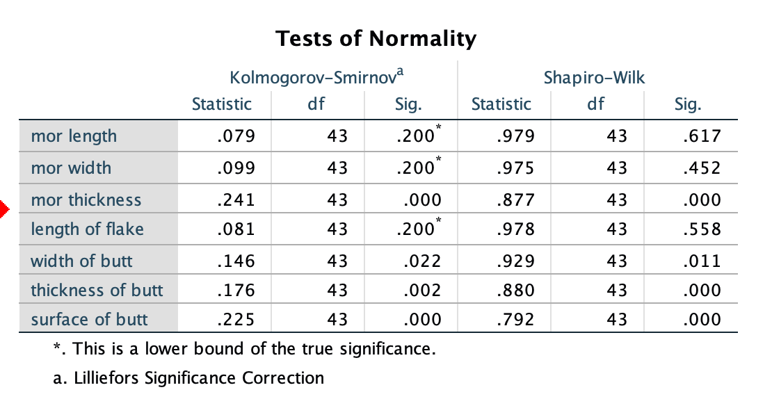
statistical significance
Test normality, because the sample size is less than 2000, so the SW test is used.The results show that the P-value of mor length, mor width, length of flake and width of butt is greater than 0.05, indicating that the distribution of these data follows normal.

Slide 2
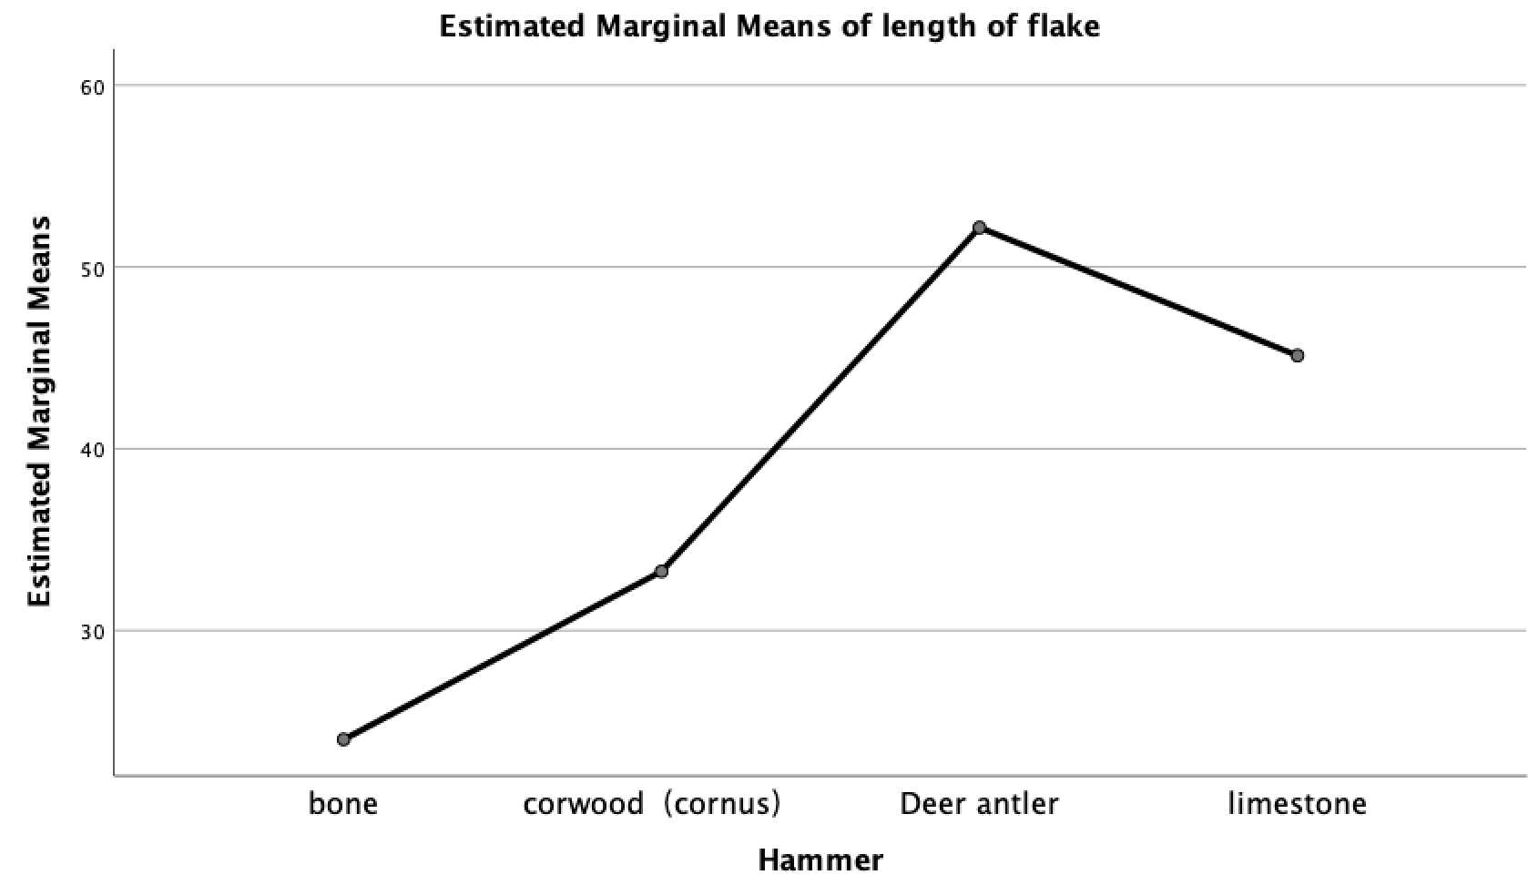
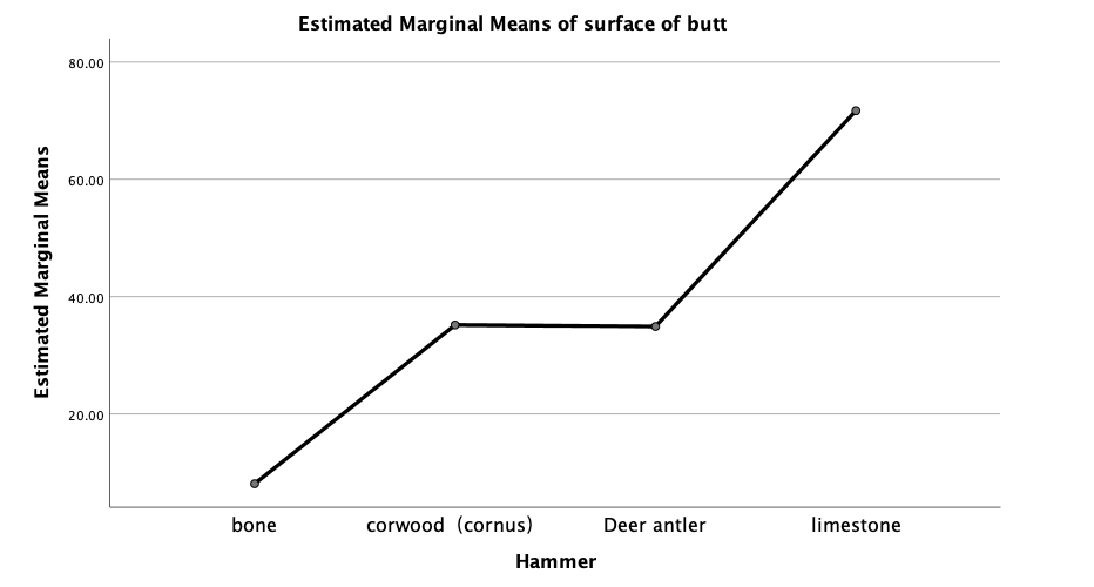
Univariate analysis showed that the length of flake of artifacts obtained from deer antler was the largest, followed by limestone, corwood and bone; but the surface of butt of the artifacts, the limestone was the largest, followed by corwood, deer antler and bone.

Slide 3
I want to study whether the length of flake is related to the surface of butt, so the peason correlation analysis(1-tailed) is conducted on the length of flake and surface of butt
The p-values obtained is 0.005（<0.01), respectively, indicating these 2 facotrs have strong relation with each other

Slide 4
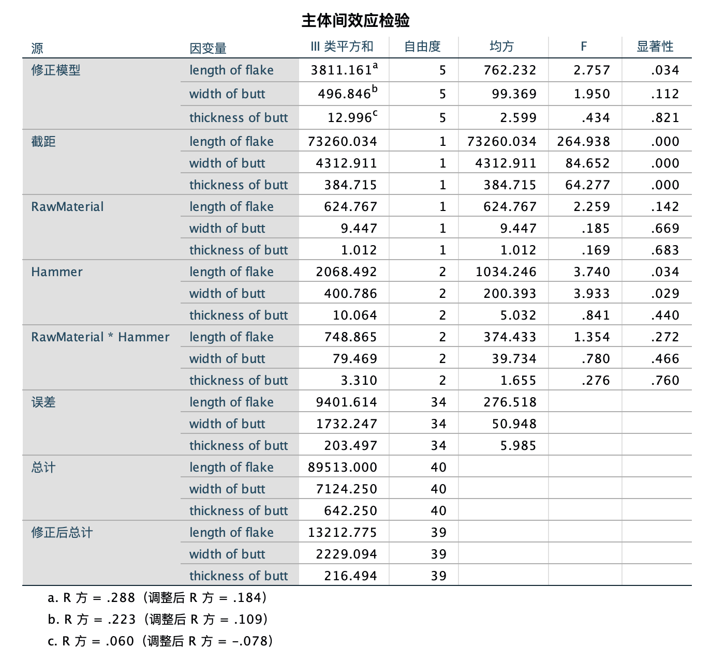
In addition, we also want to study the influence of different raw materials, different hammers on the size of artifacts and butt.
After we use multivariate linear regression analysis on it, we can see that the numbers of R2 are relatively small... It can be shown that under the results of this test, the correlation between different materials, technical lengths of hammers and artifacts and butt sizes is weak.

