Slide 1
Peri-Pancreatic Lymph Nodes
Provided by: Dr. Rita Bottino - Imagine Islet Center

Slide 2
Tips for Identification and Location of Peri-Pancreatic Lymph Nodes
color may vary from brown to red
found in the connective tissue or fat around any area of the pancreas, but mostly near blood vessels
size may vary from 3mm to 1cm in length
often organized in chains
distinguished from accessory spleens, as they tend to be smaller with a shiny surface, even if dark red

Slide 3
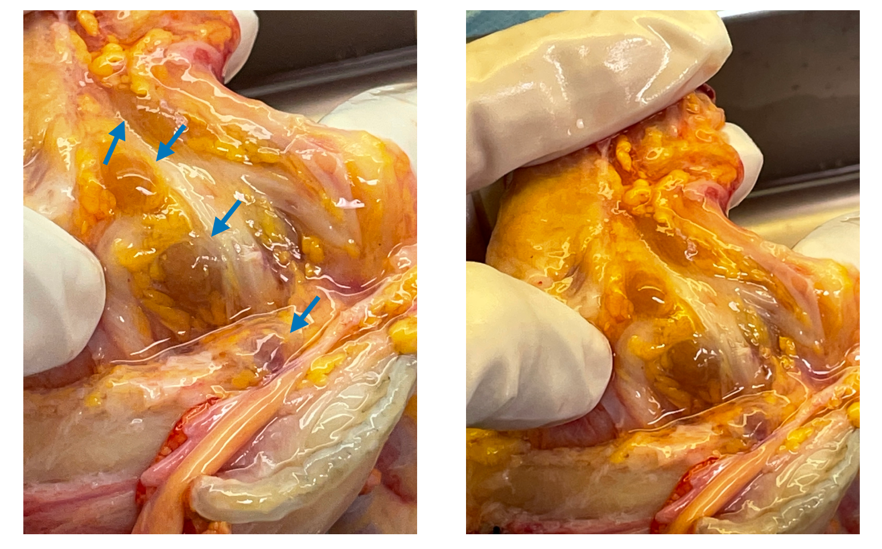

Slide 4
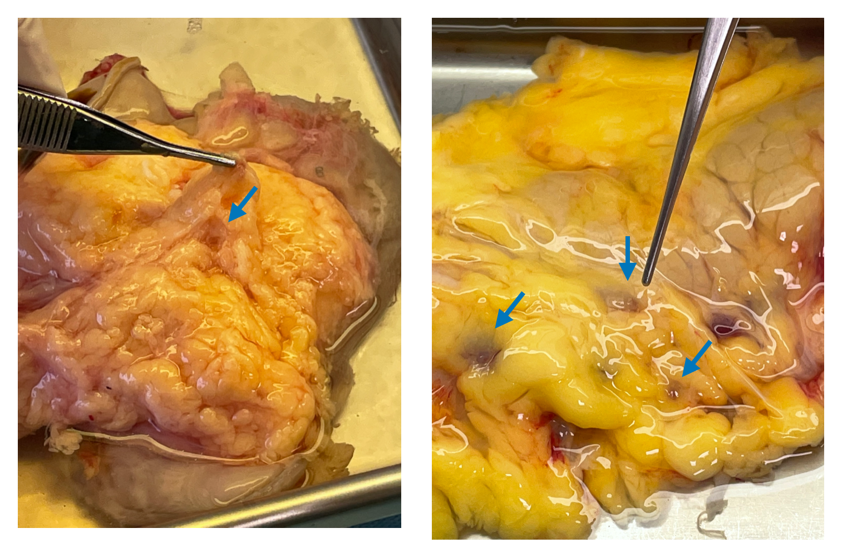

Slide 5
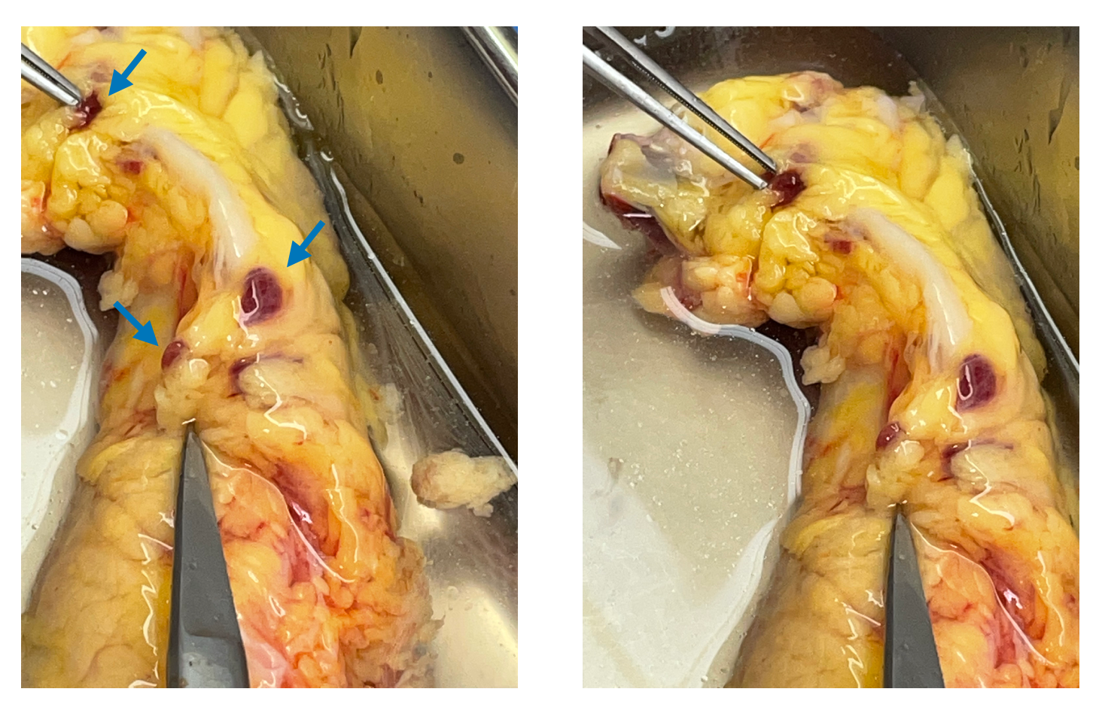

Slide 6
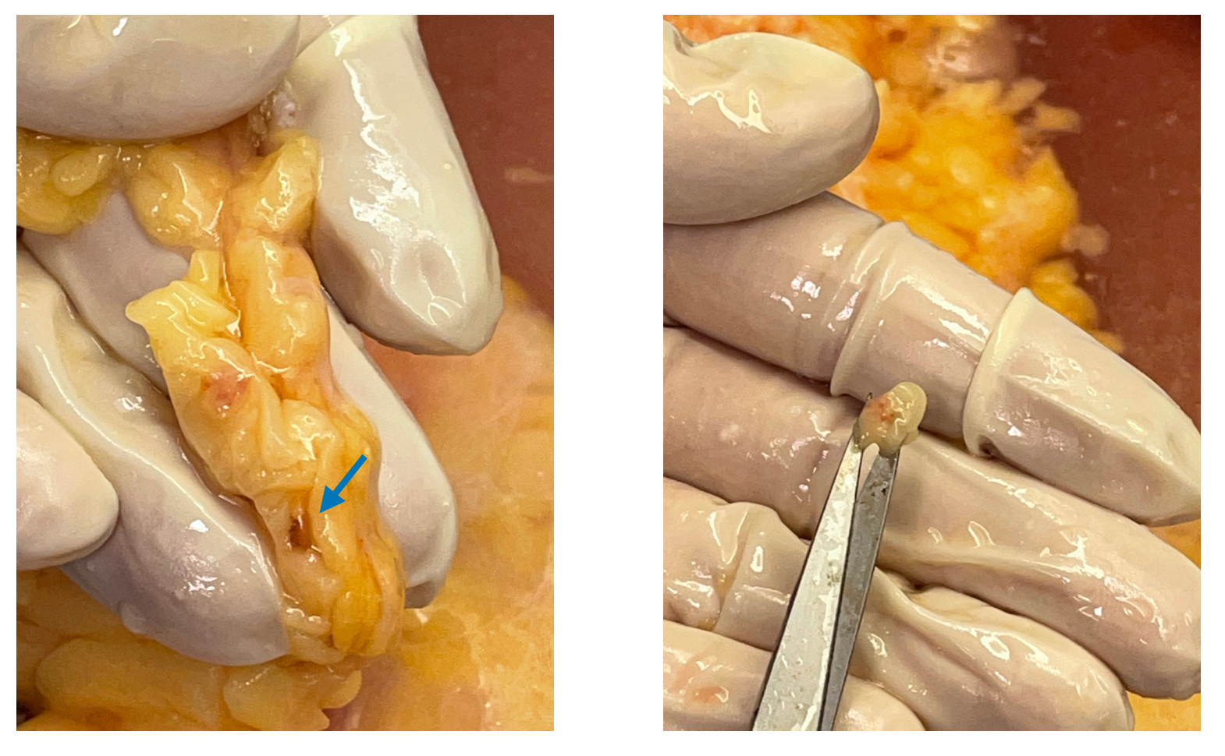

Slide 7
