Slide 1
Packaging NIPT (Acinar) for
IIDP Cold Shipping Demonstration
(Revised from the Packaging of Islets Protocol by)

Slide 2
Purpose
This presentation illustrates how to package human NIPT (Acinar) for the IIDP Cold Shipping Protocol
(Based on the Prodo Labs Shipping Protocol)

Slide 3
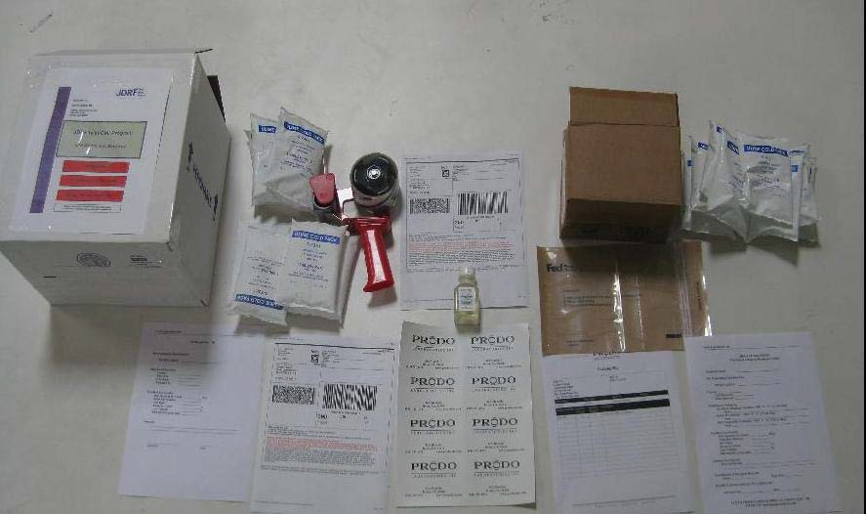
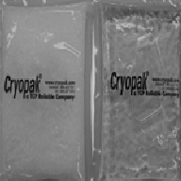
Materials per Shipment
8oz Cold Packs (Uline S-7361)
Eight @ 8°C
Two @ -20°C
Cryopak Pouches-6 oz (Cat. No. FMIS76000)
a) Four @ 8°C
3) Outer Box (Uline S-7359) 4) Inner Box (Uline S-4344)
PETG Sterile Bottles
Absorbent Pad
Quart-sized Ziplock Bag
TipTemp Indicator
Packing Tape
Islet Documentation
Shipping Documentation
3
8
1b
4
1a
2a
2a
5
7
9
10

Slide 4
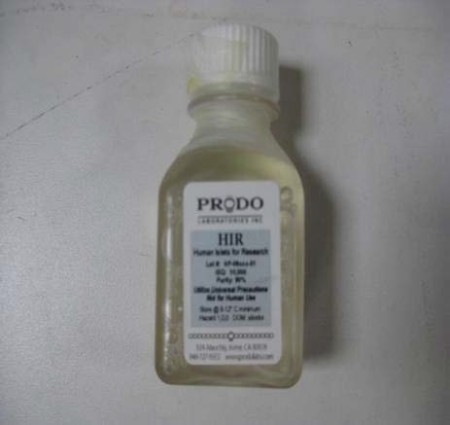
Bottle Preparation
Islets are placed in the following bottle:
0.5 – 0.75 mL NIPT pelleted tissue/ 60 mL bottle
0.76 – 1.5 mL NIPT pelleted tissue/ 125 mL bottle
1.6 – 3.0 mL NIPT pelleted tissue/ 250 mL bottle
3.1 – 5.0 mL NIPT pelleted tissue/ 500 mL bottle
Fill bottle to the halfway point of the neck with complete PIM(T)

Slide 5
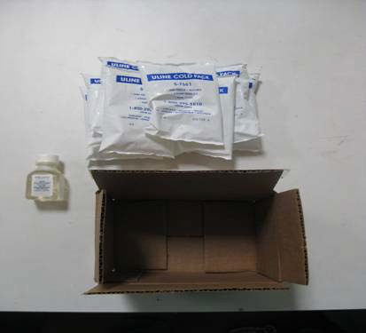
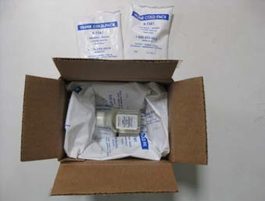
Packing Inner Box
Gather all required materials
Inner box
Absorbent pad
Ziplock bag
Six cold packs @ 8°C
NIPT in shipping bottle
Line inner box with absorbent pad
Place the shipping bottle(s) and TipTemp Indicator in ziplock bag and seal
Place shipping bottle(s) in inner box with six 8°C cold packs surrounding the shipping bottle
One pack on the bottom
Four packs - 1 on each side
One pack on top of bottle

Slide 6
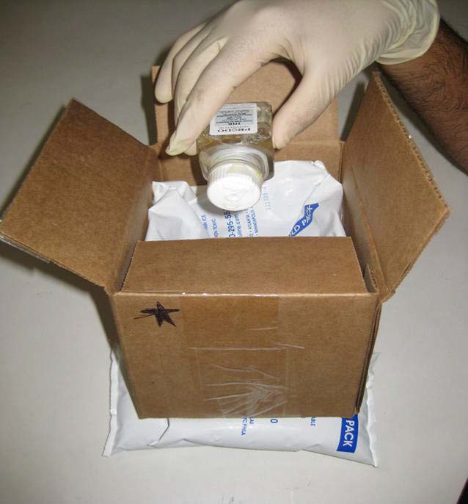
Packing Inner Box
Ensure that you clearly mark on the inner box the upright position of bottle(s) (see asterisk on box)
(The mark will be used later for correct orientation of bottle(s) in upright position when placing inner box in outer shipping container.)

Slide 7
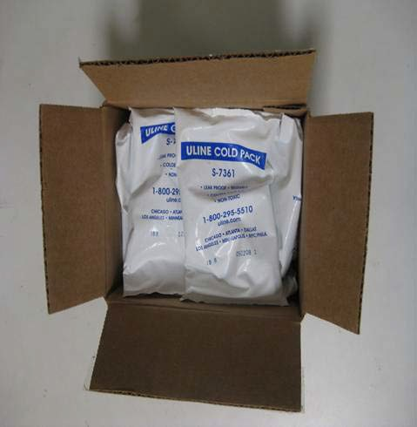
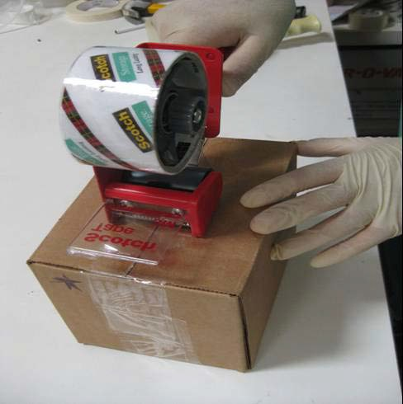
Packing Inner Box
Seal inner box with packing tape

Slide 8
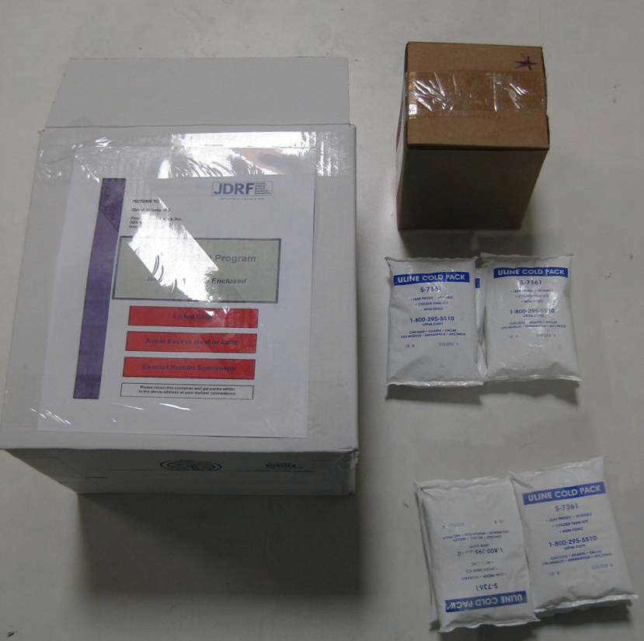
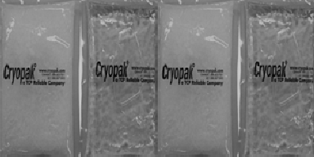
Packing Outer Box
Gather all materials for packing outer box
Four CryoPak pouches @ 8°C
Two cold packs @ -20°C
Two cold packs @ 8°C
Insulated shipping container
Ready inner box

Slide 9
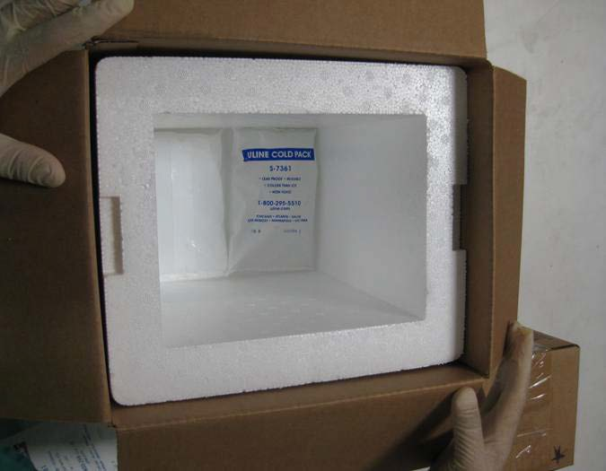
Packing Outer Box
Place one 8°C Cryopak pouch and one 8°C cold pack at the bottom of the outer box.

Slide 10
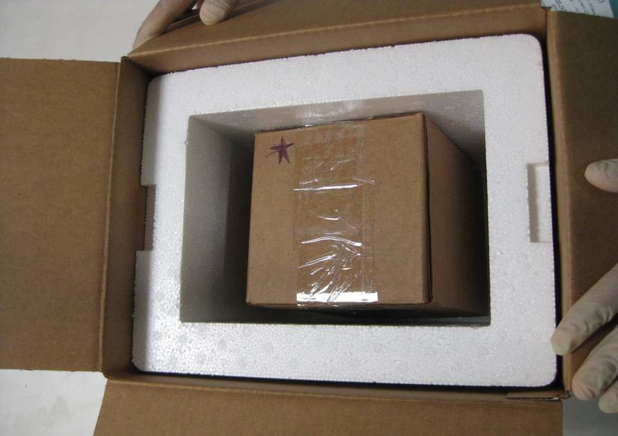
Packing Outer Box
Place the inner box on top of those two cold packs, ensure that the bottle(s) is in the upright position.

Slide 11
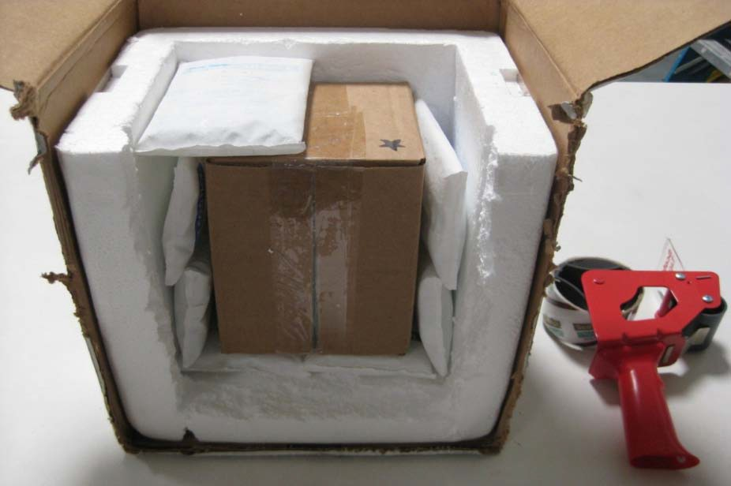
Packing Outer Box
Place two 8°C Cryopaks and two -20°C cold packs around the inner box on the short sides in a alternating pattern stacked on top of each other, such that no two same temperature cold packs are next to each other.
Place one 8°C Cryopak pouch and one 8°C cold pack on top of the inner box.

Slide 12
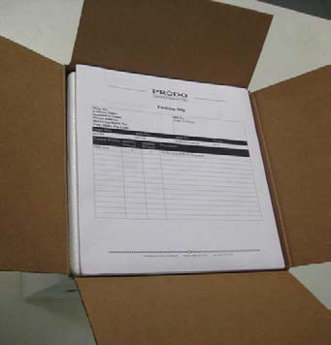
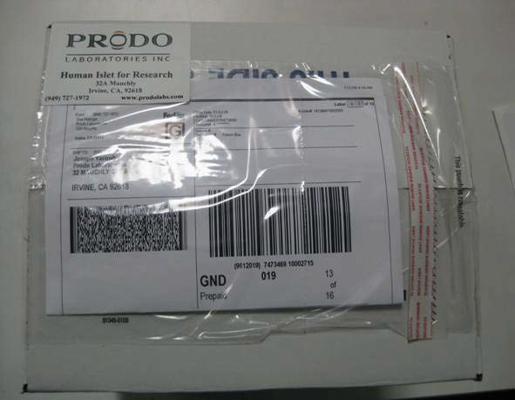
Packing Outer Box
Place the styrofoam lid on top
Put appropriate documentation on top
of the styrofoam lid
Close flaps of the shipping box and seal with packing tape
Attach "Cold Live Cells" label to box
Attach Fedex shipping label using your Recipient FedEx number to the outside of the outer box
Ship priority overnight to the destination

