Slide 1
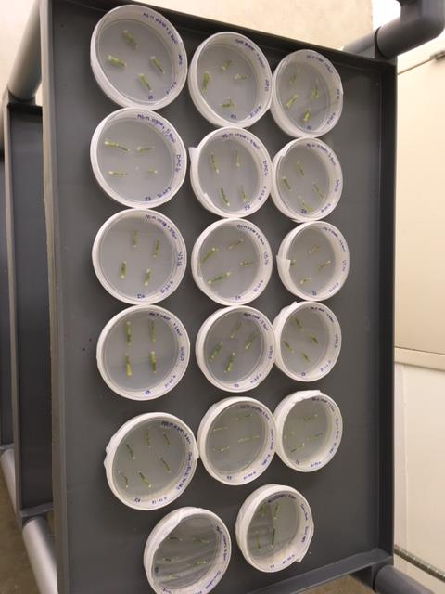
SWITCHGRASS PROPAGATION
Image Guide
GLBRC: AIM 6
Kathleen Imre September, 2018

Slide 2
Mature “Clean” Switchgrass Plants Ready for Node Harvesting

Slide 3
Mature Tiller Showing Node to be Harvested

Slide 4
“Clean” Switchgrass Nodes on MS-Maltose w/ 10uM 6-Benzylaminopurine and 5mg/L Benomyl
Blanched ends due to surface sterilization with bleach

Slide 5
Greenhouse-Grown Switchgrass: 4-10 Days Post-Plating First Visual Appearance of Sarocladium strictum Endophyte on MS-Maltose w/ 6-Benzylaminopurine, w/out 5mg/L Benomyl

Slide 6
Sarocladium strictum Growth ~2-3 days after First Appearance

Slide 7
~14 Days After Initial Plating: Viable Shoots Trimmed & Transferred to PhytaTrays with MS-M & 10uM 6-Benzylaminopurine

Slide 8
~28 Days After Initial Plating Multiple Shoots (DAC6, VS16) Ready for Transfer to Rooting Medium

Slide 9
Tall Shoots w/ Senescent Leaves (Typically AP13, WBC3) Ready for Transfer to Rooting Medium

Slide 10
Early Root Formation in PhytaTrays Containing Rooting Medium (MS-M with 1mg/L Indole-3-Butyric Acid)

Slide 11
Root Elongation

Slide 12
At ~7-9 Weeks, Rooted Plants Transferred to Clean Soil Mix

